Slide 1

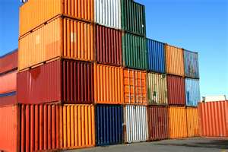




Making Standards Work For You ……..

Slide 2
Ministry of Industry, Commerce, Agriculture and Fisheries (MICAF)
The Bureau of Standards administers three (3) Acts:
The Processed Food Act 1959
The Standards Act 1968
The Weights and Measures Act 1976

Slide 3
The Mission
International competitiveness of Jamaican products
Facilitate trade
Protect consumers

Slide 4
Background
In 1969 the Bureau of Standards Jamaica was given the responsibility to monitor the observance of the Processed food Act. Under this Act, the Bureau had and still maintains the authority to appoint inspectors and analysts to inspect and analyze prescribed foods and to certify prescribed foods for the export market

Slide 5
Background cont’d
These are critical functions in
view of the fact that many countries require certification of imported foodstuff in order to ensure that the incoming product is wholesome and fit for human consumption.

Slide 6
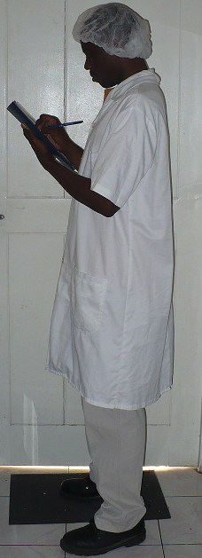
REGULATORTY FUNCTIONS
Registration – register food processing plants – for verification of compliance with specific Regulations and standards.
Inspection – Inspect sanitary conditions, hygienic practices and processing techniques in food processing establishments.
Product Sampling – Sample processed food for subsequent analyses/testing (e.g. chemical/microbiological analyses; organoleptic evaluation; package integrity checks).

Slide 7
REGULATORTY FUNCTIONS (cont’d)
4. Certification – Evaluate results of analyses/tests to ensure compliance with standards. Issue Certificate of Approval to facilitate sale locally or in the overseas market.
5. Advisory – Advise processors and potential processors on legal requirements of local and international markets.

Slide 8
Codex standards
The Codex Alimentarius or "Food Code" was established by FAO and the World Health Organization in 1963 to develop harmonised international food standards, which protect consumer health and promote fair practices in food trade

Slide 9

Tid bits of info
Canada
  All mandatory labelling information and nutritional labelling, other than the name and address of responsible party, is required to be declared in both French and English.
UK & EU
  Any exporter or agent who suspects or have any reason to believe a product that has entered a EU country can be harmful (at the production, transformation or distribution stage) to animal or human, that business operator is obliged to immediately take the necessary steps to withdraw the product (s) from the market and notify the competent authorities and users.

Slide 10



Slide 11


Questions

Slide 12
Thank You

